Slide 1


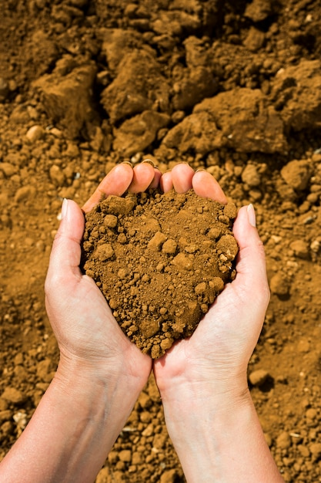





Soil Permeability
2022-1-BG01-KA220-SCH-000085065

Slide 2
Types of Soil
To better understand soil permeability, you'll need to know the types of soil and their characteristics.
There are several types of soil in Portugal.
We're going to study three of these types:
Sandy soil
Clay soil
Loamy soil

Slide 3
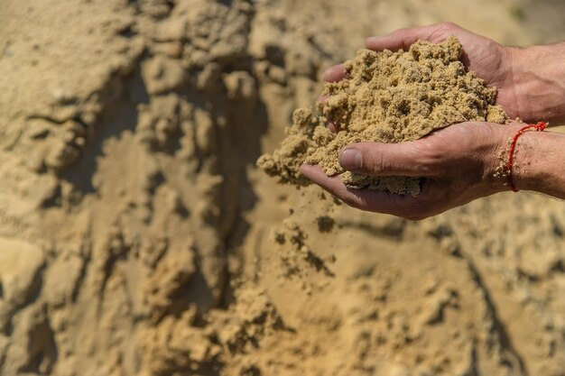
Sandy soil
Composed of around 70 per cent sand
Light, granular texture
Large pores through which water and air circulate.
Dries out quickly
Poor in nutrients
freepik

Slide 4
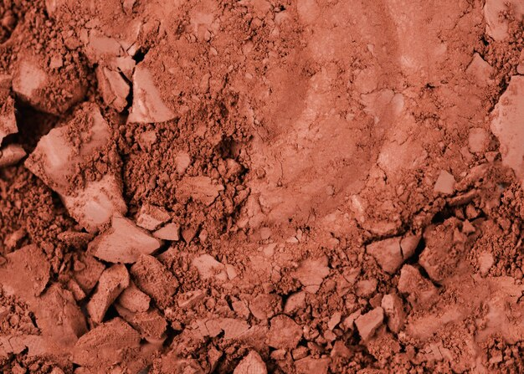
Clay Soil
Composed of more than 45% clay
Very rich in nutrients
Reddish colour
When very wet it becomes malleable; when dry it becomes hard
It has very small or almost non-existent pores through which water and air circulate
Its constituent particles are very small
freepik

Slide 5
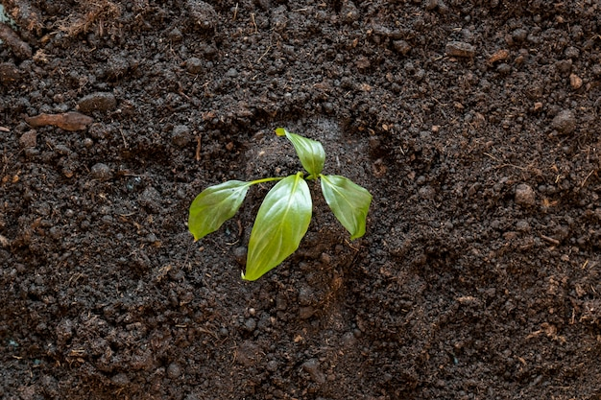
Loamy soil
Its constitution is varied
Rich in nutrients - fertile
Loose texture
Good water and air infiltration capacity
freepik

Slide 6
Soil permeability* is the capacity of a soil to allow water to infiltrate and retain in its composition.
*Physics] The term used to describe bodies through which air, light, sound, liquids, gases, etc. can pass.
*"permeable", in Dicionário Priberam da Língua Portuguesa [online], 2008-2024, https://dicionario.priberam.org/perme%C3%A1vel.

Slide 7
2022-1-BG01-KA220-SCH-000085065
Subject: Natural Science
Age of students: 9 – 10 years old
Topic: Nature
Resource Title: Soil Permeability
Credits: AECE – Escola Básica da Zona Verde
All media are within the EU intellectual property law.
The European Commission’s support for this publication does not constitute an endorsement of the contents, which reflect the views only of the authors, and the Commission cannot be held responsible for any use which may be made of the information contained herein.

